Slide 1

2021 Applied Finance Project
Factor Research for U.S. Equity markets
Anatolie Chernyakhovsky, Arshak Ghazaryan, Bardia Farajnejad, Zhenhe Zhu

Slide 2
Project
Develop investment-grade factor research for the US equity markets by using multiple data sets provided by O’Neil Global Advisors Inc.

Slide 3
Topic
The objective is to construct event-based factors that give discrete signals on which individuals may place bets.
These factors should then be back tested against historical data and compared to specific benchmarks in order to provide confirmation of the factors’ efficacy and reliability.
Event based factors can be specific corporate actions (such as special dividend declarations) but can also be derived from shifts in valuation metrics for an asset (such as a major change in a stock’s P/E ratio relative to its industry peers).
Notes:
-“Other data, such as macroeconomic factors can be used to improve the efficacy of an event-based factor using market timing”
-Other corporate actions can be annual dividend increases+/decreases-/no increase0

Slide 4
Background
Factor investing strategies are oriented on choosing assets based on characteristics that empirically provide superior risk adjusted returns. While some academics believe that these factors provide alpha, others believe that their superior returns can be related to the risks (ie they compensate for the risk by providing higher returns). Hereto date, these factors have been primarily based on two main types of factors: macroeconomic factors and style factors.

Slide 5
Background
Macroeconomic factors work by capturing broad systemic risks across asset classes. Some commonly used macroeconomic factors include: the rate of inflation, GDP growth and unemployment.
Style factors, also known as microeconomics factors, are aimed as quantifying and explaining behaviors within asset classes. The most famous style factors are those in the Fama-French multifactor models. Though they can also be created to include key metrics of financial fundamentals.

Slide 6
Background
Event studies that measure excess return in the periods surrounding significant financial events have also been carried out extensively in the past. The novelty, therefore, is the defining of new events, based on changes or triggers within financial metrics, and analyzing their performance.

Slide 7
Background
Discrete indicators are “signals” such as a stock’s 5-day moving average moving above its 50 day moving average, a stock’s book-to-market characteristic moves from the 80% quantile to the 20% quantile in its industry, or a major change in a stock’s P/E ratio relative to its industry peers. These events can be translated into buy or sell signals, and their usefulness should be tested by measuring tradability, Sharpe ratios, and statistical estimates of the strategy’s alpha relative to a set benchmark along with clearly defined estimation errors.
Continuous indicators are “scores” that include accounting variables such as Book-to-Market ratios and Profitability (normalized by ROE) ratios; however the goal of this project will be to map these continuous variables to an event-based signals.
Notes:
Focus: find novel signals that lead to outperformance relative to a set benchmark (and that are not correlated with existing signals… that is, they should be marginally useful above and beyond well-known existing factors)

Slide 8
Project Phases
Summer Research
Monthly check-in
Event-driven factor ideas
Schedule a meeting
Spring 2021
Fall 2021
Winter 2021
Summer 2021
Meeting with O’Neil
Scope of Project
Literature Review
Getting the data
Replicate Fama French
Test factor ideas
Develop a trading strategy
Back-test
Visualize performance
Present findings
Notes:
Schedule a meeting: Sending an email to O’Neil Capital Management introducing ourselves and scheduling an introductory meeting

Slide 9
Goal of Project
Other sources of alpha
Scores
Sources of alpha
Create model
Deliver results
Signals
Generate alpha

Slide 10
Modeling Events
Waiting time between successive events is Exponentially distributed
time
Number of events in a fixed time interval follows a Poisson distribution
Fixed time ‘A’
Fixed time ‘B’
A successful model would follow a Jump-Diffusion process, where a jump at any time can be predicted beforehand by our model
Notes:
-If the asset follows a Jump-Diffusion process, we are attempting to trade on stock-specific jumps
-Our goal is to find stock specific events that occur with frequency λ in a fixed time interval
-Then the time between successive events is random and is Exponentially distributed
So this is just to get an idea
Poison → discrete #=0 times,1 times, 2 times,...
Exponential → measures time so it is continuos

Slide 11
Analysis Strategy
Create new stock specific signals (discrete “events”, which can come from mapping continuous “scores” to an event-based signal) that may lead to outperformance.
We will use economic intuition and take into account investor behavior and structural market inefficiencies that could explain excess returns.
These signals should not be correlated with existing factors that are already well known; thus, we will have to figure out the relationship between our signals and other well-known factors.
Test the effectiveness of our novel signals and their ability to predict future excess returns (show overall performance historically, test out-of-sample performance, control for time effects and industry fixed effects, normalize for time varying changes in volatility, etc). Compare and evaluate test results against a benchmark set of factors.
Evaluate whether the strategy is feasible (trading costs, turnover and average days in portfolio, other inherent risk exposures, etc). Also, evaluate whether exponentially weighting the data (downweighting the past and putting more weight to the more recent data) would create improvements in our signals.
Notes:
-EX 1-2: Stock goes from bin 5 (quintile 5) to bin 3 (quintile 3) [economic intuition is: from best in class stock to an average stock]
-3) run OLS
-4) Can do this overall, or can control for industry effects
-4) time varying vol: 18% with lots of vol in one period, but can do 18% and very small vol in another time period
-Macro factors is not stock specific, but maybe can help us with the amount of leverage that we take on

Slide 12
Data
· Stock price, accounting metrics, fundamental ratios, and ownership data provided by O’Neil Global Advisors (factor research database that includes several discrete technical trading events and continuous score-based metrics)
· Stock returns and existing known factor returns from CRSP (WRDS database)
· Accounting variables from Compustat (WRDS database)
· Macroeconomic factor data from FRED
· Textual indicator data (social media stats, ESG ratings, congressional signals) from Bloomberg

Slide 13
Rank EPS Study
by Ronald P. Ognar, Chris Graczyk, and Stephen Westwood
O’Neil uses a proprietary EPS ranking system based on decile, sector and liquidity. This measure of growth earning and stability is employed at O’Neil as a primary construction method for portfolios of US equities.
Based on backtesting and random selection tests, this factor was shown to be a viable predictor of future stock price performance. Portfolios of stocks with higher EPS ranking also demonstrated lower turnover than portfolios with lower EPS ranking.

Slide 14
New Highs: Outperformance Increases with Lookback Window
by Timothy Marble and Ronald P. Ognar
By going against the conventional wisdom of “buy low, sell high,” the setting of new highs by a stock can be a signal of future outperformance.It was found that after achieving a new high, on average, a stock will continue to outperform the market for about one year.
Additionally, by extending the lookback window for defining new highs, the stock performance tends to increase. Adjusted for volatility, new highs as an indicator of future performance has been remarkably consistent over time.

Slide 15
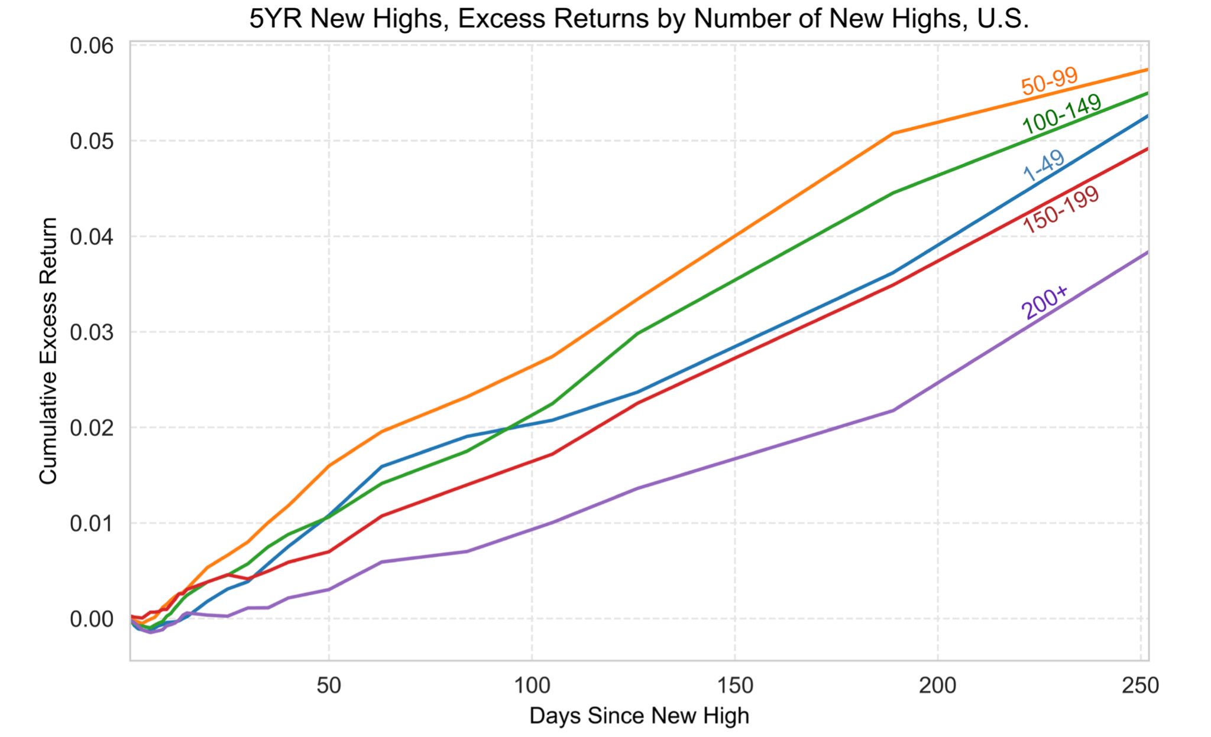
New Highs: Best Served Rare
by Timothy J. Marble and Ronald P. Ognar
New highs that occur on days when there are less than 100 total new highs significantly outperform those that occur when there are more than 200 new highs
“A rising tide lifts all boats” and “When the tide goes out, you find out who’s been swimming without shorts”
Many new highs are explained by overall market appreciation rather than the existence of new/unique information. That is, many new highs have no idiosyncratic driver, but rather are explained by the tide of the market.
Notes:
-The effect is largest for large growth stocks
-This outperformance means that rare new highs reveal thematic investment preferences and emerging cyclical patterns and trends in sector rotation (strategy has second order momentum effects)
-Thus, when we control for the number of new highs (ie control for the tide of the market), we can distinguish the most promising stocks… specifically, new highs that occur on days when new highs are rare are more likely to outperform than new highs that occur on days when new highs are plentiful.

Slide 16
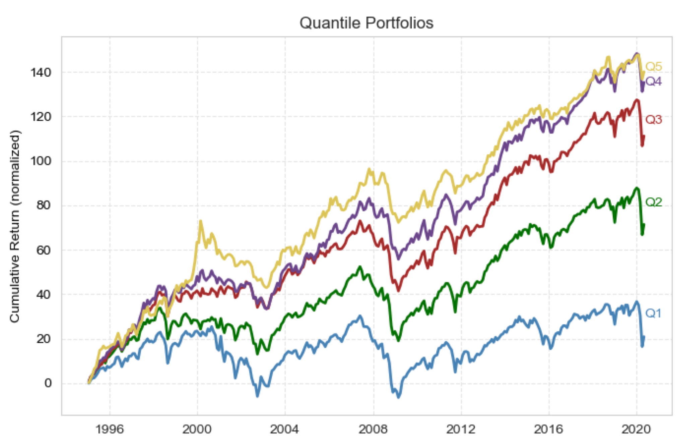
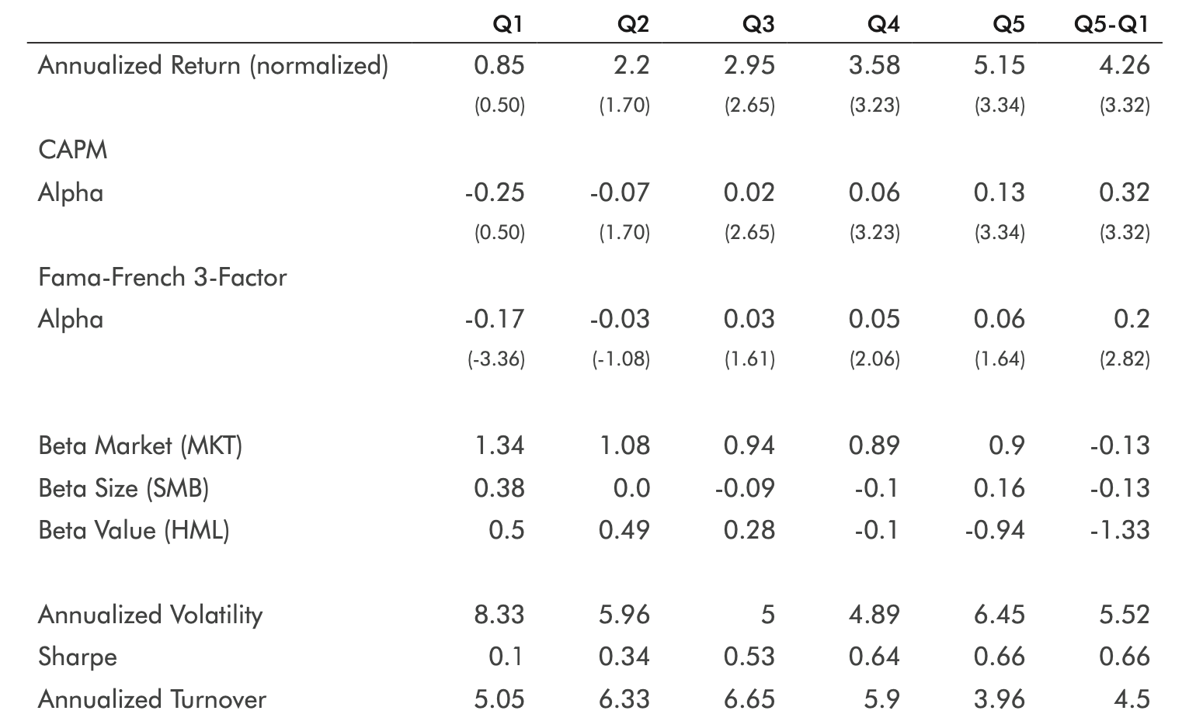
RS Rating: It’s All Relative
by Timothy J. Marble and Ronald P. Ognar
Demonstrating the effectiveness of a proprietary “Relative Strength” (RS) Rating
Portfolios of stocks with the highest RS ratings have higher returns and lower volatility than those portfolios with the lowest RS ratings
Results are liquidity weighted and normalized with respect to time varying volatility
Strategy does not provide perfectly smooth returns, thus investing by RS Rating is not risk-free but rather represents broader exposure to market movements
Notes:
RS is basically tracking momentum: “proprietary RS Rating measures a stock’s relative price performance over the last 12 months against that of all stocks in our U.S. database, with extra weight assigned to the latest three-month period (with each remaining quarter receiving a lesser weighting)... stocks are ranked in order of greatest to least price percentage change and assigned a percentile rating from 1 (worst) to 99 (best)
Top graph: monotonically increasing average returns to quintile portfolios as average RS Ratings increase.
Cross sectional quntile sorts from 1995-2020 → Q5-Q1 is a market-neutral Long/short portfolios that earned statistically significant positive returns while hedged against broader market exposures
Testing Methodology:
using time series results of Q5-Q1 portfolios, run (OLS) against the liquidity-weighted market portfolio (MKT) and two Fama-French factor portfolios, returns of small caps versus large caps (SMB) and returns of value stocks compared with growth stocks (HML). (check if Q1-Q5 portfolio provides alpha above and beyond…)
Also, form a Q5-Q1 portfolio by running an OLS regression of Q5 returns against those of Q1 and using the resulting slope coef as a hedge ratio.
Adjusting for intertemporal changes in market volatility, such effects are relatively robust over time… HELPS AVOID periods of higher volatility contributing disproportionately to average returns and measures of risk. In periods like 1995–2000, there might have been more volatility overall such that positive returns would have been greater in magnitude as well. Thus, the authors remove some of this noise by normalizing over time using point-in-time estimates of broader market volatility.ACHIEVED BY [[(achieve this by dividing each day’s portfolio returns by model-based point-in-time estimates of market volatility. This results in performance figures expressed in constant volatility units, rather than actual percent returns, but can be converted for practical estimation purposes into percentages by multiply- ing by the portfolio manager’s target volatility)]] ----> more realistic and proactive risk-control strategy that categorically reduces exposure during times of turmoil (ie vol is large) and increases it when markets are calm (ie vol is low)----> despite short-term cycles, the effect has been consistent and robust over time --->
TABLE: (Note that such returns are expressed in constantly volatility units, which can roughly be translated into percentage returns by multiplying by 0.03). The Q5 portfolio has both a higher annualized return, 5.15 versus 0.85 (equating to 15.5% and 2.55%, respectively, when we multiply by 0.03 average), and lower annualized volatility, 6.45 versus 8.33 (19.4% versus 25.0%), than the Q1 portfolio. The risk-return tradeoff is summed up succinctly by the Sharpe ratio of 0.66 for the Q5 portfolio versus 0.1 for the Q1 portfolio. The effect of noise removal is now evident in the superior Sharpe ratio of 0.66 for the volatility-adjusted Q5-Q1 portfolio compared with 0.51 for the raw return Q5-Q1 portfolio in Table 1 (not shown here in this slide).

Slide 17
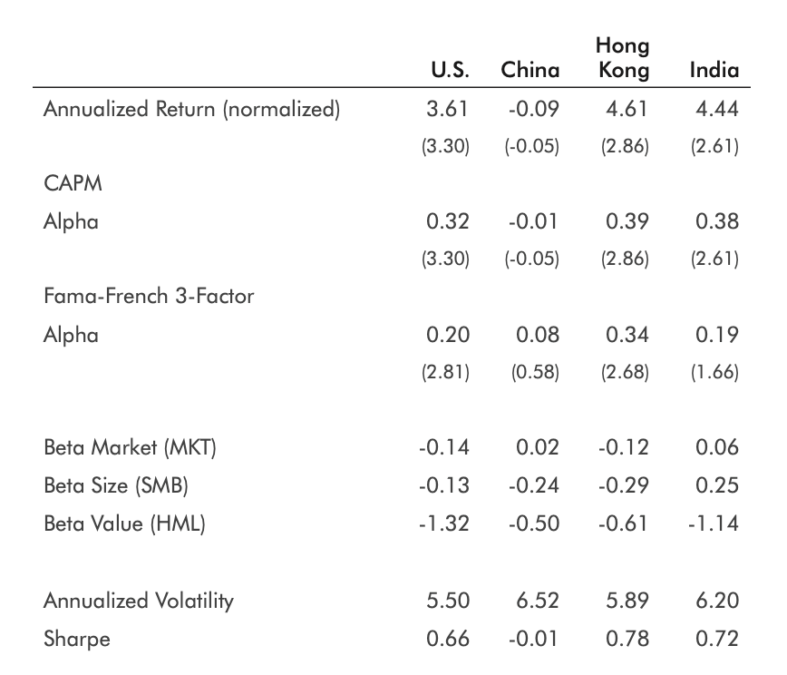
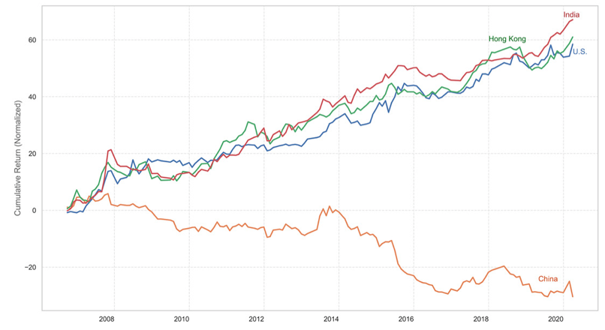
RS Rating: Segmentation
Size & Style Quantile Long-Short Portfolio
Author: Timothy Marble
Notes:
RS Rating-based quantile long/short portfolios of small caps beat those of large caps on a risk-adjusted basis.

Slide 18
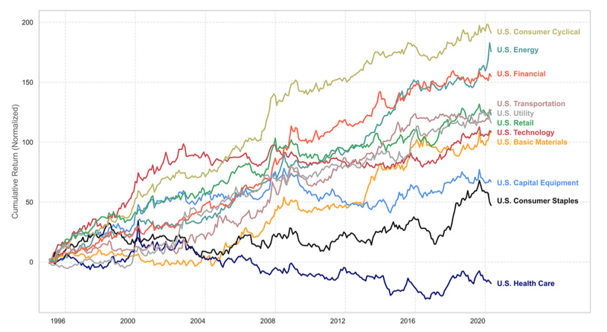
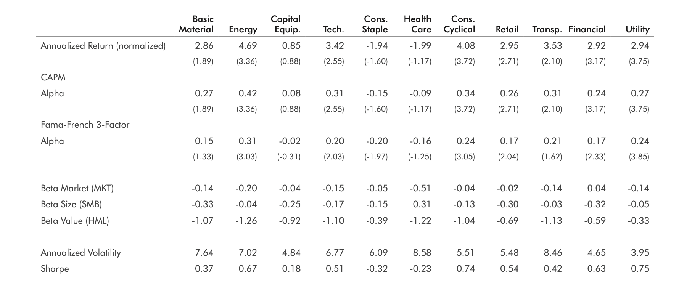
RS Rating: Segmentation
Long-short portfolio
on sector level
Notes:
Sector-level analytics show opportunities to enhance performance by tactically excluding poorly performing sectors
Long-short portfolios on industry level

Slide 19
ATH Anomaly: Analysis via style, size, and geography
“New Highs: Across the Board and Around the World” - Marble & Ognar (2020)
Recap:
Reaching ATH is a bullish signal
Goal:
Discover relative outperformance from sources of ATH signal (inefficiencies)
Portfolios by segmentation:
Size
Style
Industry
Geography

Slide 20
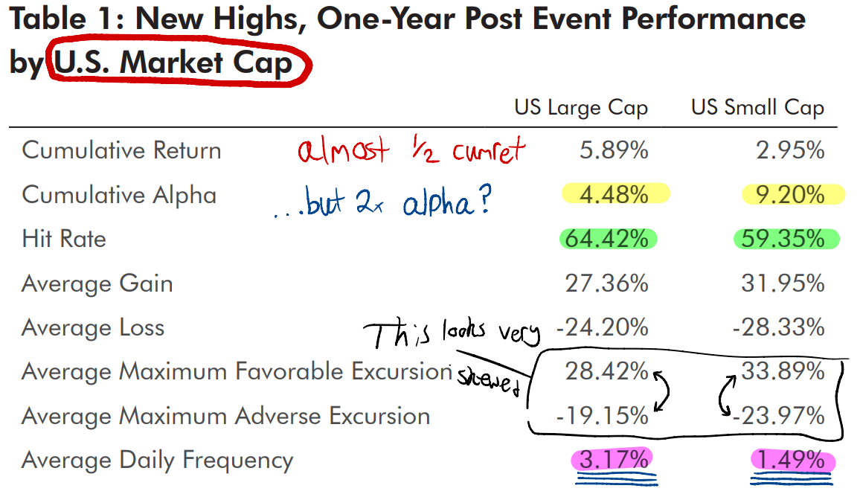
ATH Anomaly: Size segmentation portfolio results
“New Highs: Across the Board and Around the World” - Marble & Ognar (2020)
Notes:
Period: 1995 to 2018.
Results statistically significant at 99% confidence level.
‘Cumulative alpha’ is based off CAPM
S&P500 is proxy for market returns
‘Hit Rate’ is the percentage of events on average yielding positive returns
‘Average daily frequency’ is the average proportion of US equity universe experience a new high with respect to the window length on a given day

Slide 21
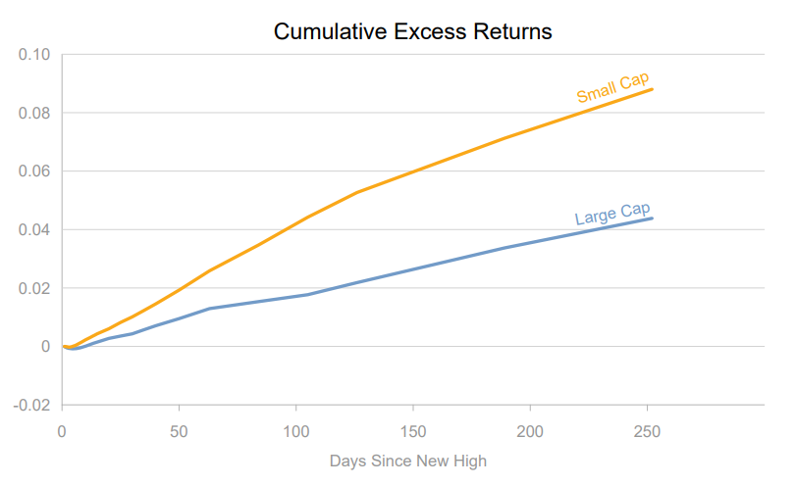
ATH Anomaly: Size segmentation portfolio results
“New Highs: Across the Board and Around the World” - Marble & Ognar (2020)
Notes:
Talk CAPM

Slide 22
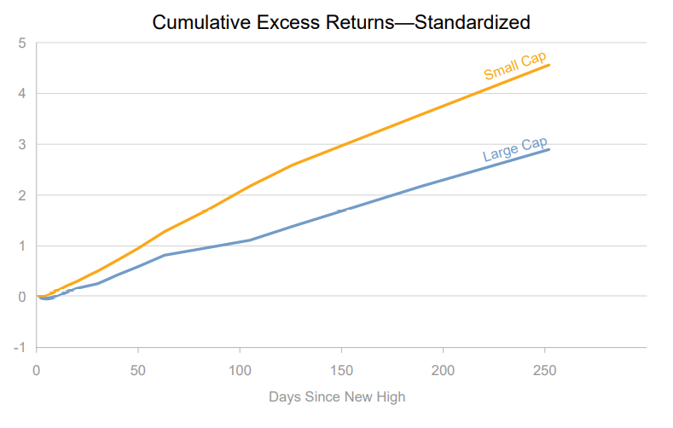
ATH Anomaly: Size segmentation portfolio results
“New Highs: Across the Board and Around the World” - Marble & Ognar (2020)
Notes:
Talk CAPM

Slide 23
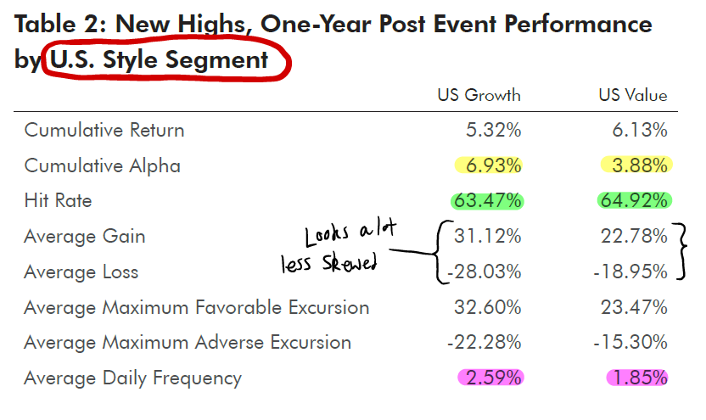
ATH Anomaly: Style segmentation portfolio results
“New Highs: Across the Board and Around the World” - Marble & Ognar (2020)
Notes:
Talk CAPM

Slide 24
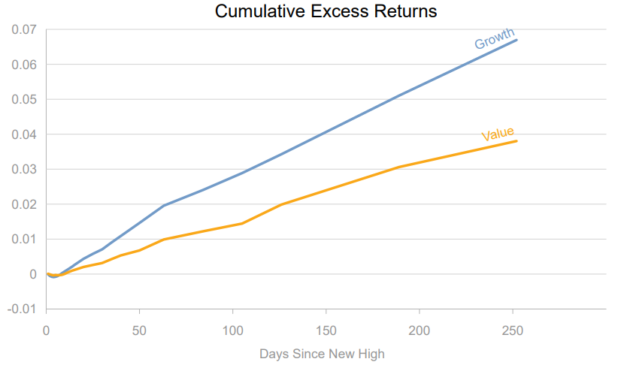
ATH Anomaly: Style segmentation portfolio results
“New Highs: Across the Board and Around the World” - Marble & Ognar (2020)
Notes:
Talk CAPM

Slide 25
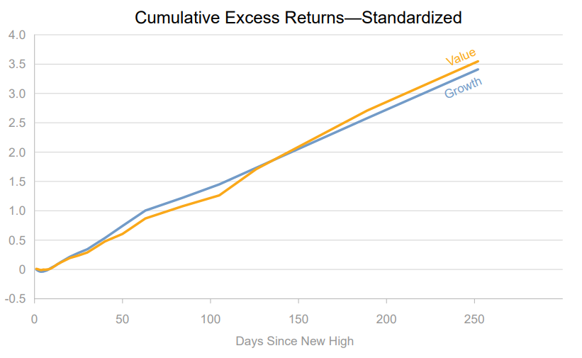
ATH Anomaly: Style segmentation portfolio results
“New Highs: Across the Board and Around the World” - Marble & Ognar (2020)
Notes:
Talk CAPM

Slide 26
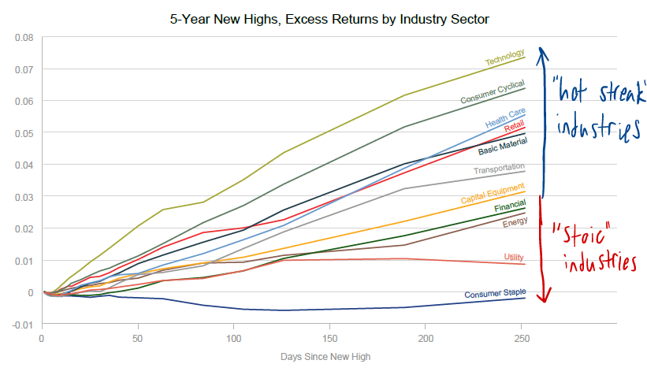
ATH Anomaly: Industry segmentation portfolio results
“New Highs: Across the Board and Around the World” - Marble & Ognar (2020)
Notes:
Intuitive results. Researchers opted not to control for volatility, likely because these industries can already be defined using the previous two segments.

Slide 27
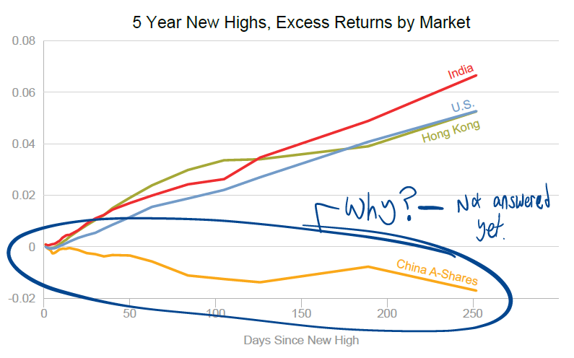
ATH Anomaly: Geographic segmentation portfolio results
“New Highs: Across the Board and Around the World” - Marble & Ognar (2020)
Notes:
Talk CAPM

Slide 28
ATH Anomaly: Conclusion
“New Highs: Across the Board and Around the World” - Marble & Ognar (2020)
The ATH anomaly is. . .
Bullish in Many large geographic markets besides China A-Shares
Not a source of relative outperformance in most cases
Not robust to controls for volatility in most cases
Exceptions:
Relative outperformance in size-segmented market portfolios
Robust to controls for volatility
Market inefficiencies or transaction costs?
Notes:
Talk CAPM

Slide 29
Questions

